Slide 1
Chapter 2
The C# Language

Slide 2
C#
Similar to Java
Compiled Language
Object Oriented
Strongly typed
Case-Sensitive

Slide 3
Basics
Comments
Noted with two backslashes (//) for a whole line of comments
Noted with backslash – asterisk (/*) for the start of a multiline comment and ends with an asterisk – backslash.
Blocks
Start with Left Curly-Brace ({). Ends with matching Right Curly-Brace (})
Statement Termination
Statements end with semi-colon (;)

Slide 4
Variables and Datatypes in C#
Numeric Types:
byte
short
int
long
float
double
Decimal
Character Types:
char
String
Other:
boolean
object

Slide 5
Assignment and Initializers
// Declare variables.
int errorCode;
string myName;
// Assign values.
errorCode = 10;
myName = "Matthew";
//Declare and assign at the same time
int errorCode = 10;
string myName = "Matthew";

Slide 6
Arrays
Arrays allow you to store a series of values that have the same data type
string[] stringArray = new string[4];
// Create a 2x4 grid array (with a total of eight integers).
int[,] intArray = new int[2, 4];
// Create an array with four strings, one for each number from 1 to 4.
string[] stringArray = {"1", "2", "3", "4"};

Slide 7
The ArrayList
Variable Length
ArrayList dynamicList = new ArrayList();
dynamicList.Add("one");
dynamicList.Add("two");
dynamicList.Add("three");

Slide 8
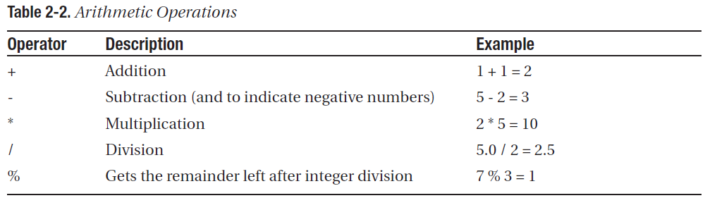
Variable Operations

Slide 9
Object-Based Manipulation
string myString;
int myInteger = 100;
// Convert a number to a string. myString will have the contents "100".
myString = myInteger.ToString();

Slide 10
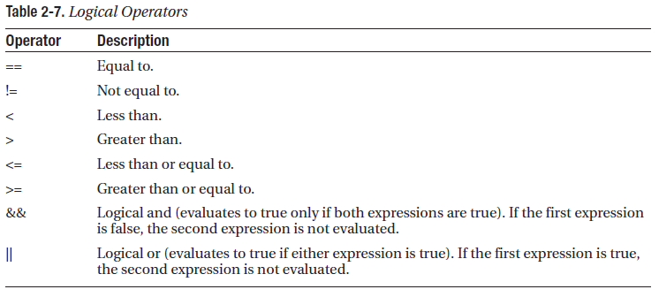
Conditional Logic

Slide 11
If Statement
if (myNumber > 10)
{
// Do something.
}
else if (myString == "hello")
{
// Do something.
}
else
{
// Do something.
}

Slide 12
The for Loop
for (int i = 0; i < 10; i++)
{
// This code executes ten times.
System.Diagnostics.Debug.Write(i);
}

Slide 13
Methods
// This method doesn't return any information.
void MyMethodNoReturnedData()
{
// Code goes here.
}

Slide 14
Parameters
private int AddNumbers(int number1, int number2)
{
return number1 + number2;
}

Slide 15
New Console Project
Open Visual Studio
Choose File → New Project
Choose Visual C# → Windows → Console Project

Slide 16
System Generated Code
using System;
using System.Collections.Generic;
using System.Linq;
using System.Text;
namespace ConsoleApplication3
{
class Program
{
static void Main(string[] args)
{
}
}
}

Slide 17
Print Text
System.Console.WriteLine("Hello world");
To stop the Program from executing before the user presses a key:
System.Console.ReadKey();

Slide 18
Read text from user
string name = Console.ReadLine();

